Slide 1
Somerset County
2017 Introduced Budget
Presentation
Somerset County Board of Chosen Freeholders
Peter S. Palmer, Director
Patrick Scaglione, Deputy Director
Mark Caliguire
Patricia L. Walsh
Brian Levine

Slide 2
Somerset County 2017 Budget
Prepared and Presented By
Michael Amorosa
County Administrator
Nicola Trasente
Director of Finance and Administrative Services
Chris Hart
Deputy Director of Fiscal Operations

Slide 3
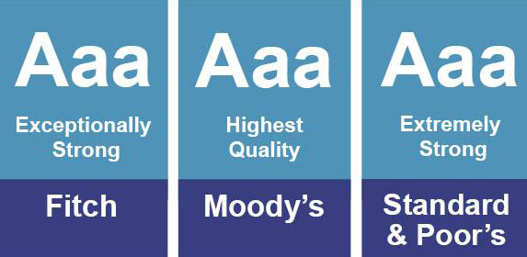
Bond Rating

Slide 4
Regenerated Fund Balance
Year Beginning Utilized Regenerated Sub-Total Ending
2013 $34,225,092 $16,056,199 $14,276,174 $32,445,157 $32,445,157
2014 $32,445,157 $15,900,000 $21,803,967 $38,349,124 $38,349,124
2015 $38,349,124 $19,725,000 $21,339,747 *$39,963,871 $37,963,871
2016 $37,963,871 $19,000,000 $23,811,641 *$42,775,512 $40,775,512
2013-2016
Fund Balance has increased by $8,330,355
Reserves for Emergencies increased by $4,000,000
Total Reserve and Fund Balance increase $12,330,355
*Denotes years when $2,000,000 was placed in reserve for Snow and Self-Insurance Emergencies.

Slide 5
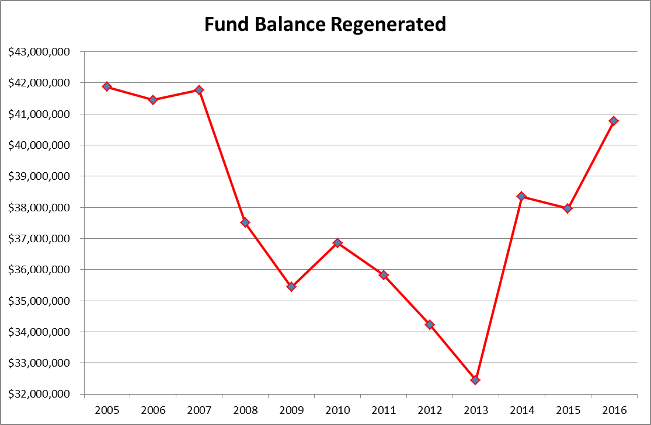

Slide 6
Cost Drivers
Budget Line Increase
Group Health Insurance $1,408,299
Criminal Justice Reform $1,154,048
Parks Commission Contribution $560,000
*911/Dispatch Services S&W $511,766
Pension $483,328
Special Security-Presidential Detail $90,000
* Budget Items that Provide Added Service to County Residents

Slide 7
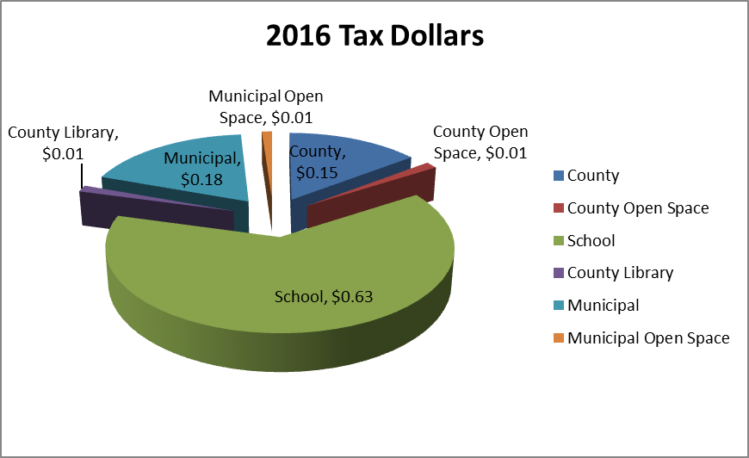
Where Do Your Tax Dollars Go?
2016 – For every property tax dollar paid only $.15 cents (on average) was sent to Somerset County

Slide 8
What does this budget do?
Maintenance of 248 centerlane miles of County roads and 752 bridges.
38 park, recreation and open space areas encompassing
15,000 acres.
Fully Funds New Salary Guide 911/Dispatch Communications for 20 Municipalities.
Funds Nearly 200 Shared Services with Local Governments and Other Organizations in the County.
Funds Partial Budgets Vocational School, Community College, Social Services and Parks Commission.
Fully Funds County Fire Academy.
Establishes Somerset County Insurance Commission
Fully Funds County Employee Health Center
Fully Funds Cost of Criminal Justice Reform

Slide 9
Shared Services
Cost Shared with Other Agencies
Recycling- 19 Municipalities, including schools
Transportation- 3 municipalities, 4 Non-Profits
Vehicle Maintenance - 14 Municipalities
Vehicle Fuel- Over 50 Agencies
Fire Academy Service- State Wide
Health Services- 8 Municipalities
Housed Inmates from Hunterdon County
Cost Covered by County Only
911 PSAP - 20 Municipalities
Full Dispatch Service- 14 Municipalities, 14 Police Departments, 38 Fire Departments and 18 EMS Stations.
Cooperative Purchasing Program – State Wide
Notes:
2/12/16- Transportation info the same.
2/25/16- John’s note was that they provide recycling services for 19 municipalities which includes schools and many other county facilities. Is that necessary information to include?

Slide 10
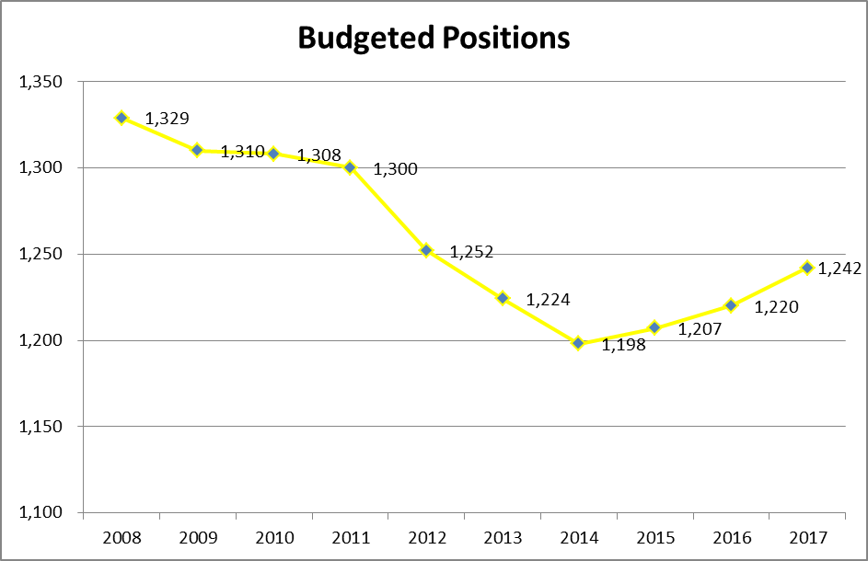
Number of Employees
Decrease from 2008 to 2017 by 7%

Slide 11
Total Budget-Expenditures

Slide 12
County Dept. vs Other

Slide 13
County Dept. vs Other

Slide 14
Total Budget-Revenue

Slide 15
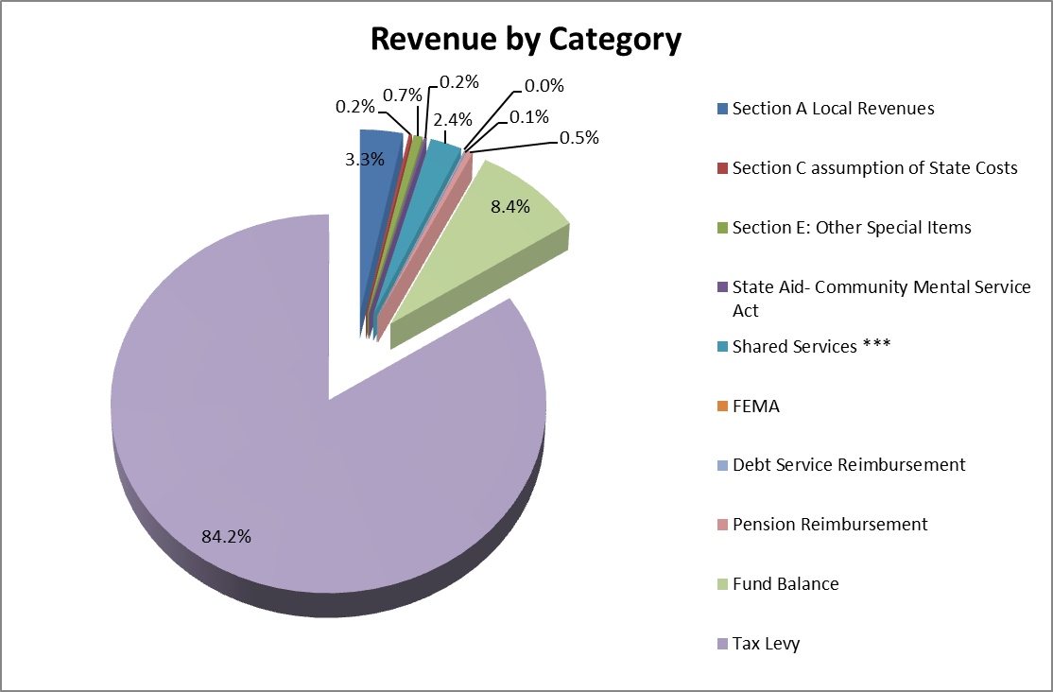
Revenue

Slide 16
Cost We Can Control/Cost We Are Obligated For
 | 2008 | 2017 | %Chg | %
County Departments | $63,333,814 | $64,112,014 | 1.23% | 83.67%
Capital | $22,300,000 | $6,050,000 | -72.87% | 7.90%
Other | $6,725,157 | $6,461,983 | -3.91% | 8.43%
Total Controllable Cost | $92,358,971 | $76,623,997 | -17.04% | 100.00%
Constitutional Services | $4,332,689 | $4,010,739 | -7.43% | 2.75%
Public Safety | $32,284,607 | $36,654,601 | 13.54% | 25.15%
Debt Service | $16,056,464 | $17,457,008 | 8.72% | 11.98%
Outside Agencies | $38,184,186 | $39,819,948 | 4.28% | 27.32%
State Programs | $11,359,857 | $2,648,309 | -76.69% | 1.82%
Pensions | $4,804,459 | $13,209,701 | 174.95% | 9.06%
Insurance | $15,445,000 | $31,944,813 | 106.83% | 21.92%
Other | $5,388,837
Total Obligated Cost | $127,856,099 | $145,745,119 | 13.99% | 100.00%

Slide 17
Cost We Can Control

Slide 18
Cost We Are Obligated For

Slide 19
Total Cost

Slide 20
Cash Capital
Total Cash Capital $6,250,000
Amount for Down Payment on Bonds $1,000,000
Reserve for Green Brook Flood Control $700,000
Reserve for Preliminary Cost $700,000
Fleet Vehicles Replacement $250,000
Other Capital Requests-Contingency $0
Various Capital Projects – Capital Ord. $3,600,000

Slide 21
Increase In Assessed Value
Total Equalized Assessed Value
(In Billions)
2014 2015 %Increased
$56,382 $57,406 1.81%
2015 2016 %Increased
$57,406 $58,147 1.29%
2016 2017 %Increased
$58,147 $59,076 1.60%
3 Year Increase = 4.70%

Slide 22
Tax Rate Effect on Avg. Home of $423,006 $5 per year for 2017
COUNTY OF SOMERSET
2017 Introduced Budget Info
 |  | 2016 | Intro 2017 | Dollar Change | % Change
Total Net Value Assessed |  | 58,147,470,049 | 59,075,732,871 | 928,262,822 | 1.60%
Total Budget w/ Grants
County Levy |  | 185,839,652 | 189,507126 | 3,674,394 | 1.97%
Without Grants |  | 239,845,899 | 222,369,116 | (17,476,783) | (7.3%)
Grants
Tax Rate |  | 0.3201 | .3213 | .0012 | 0.37%
Average House Annual Tax |  | $ 1,354 | $1,359 | $5 | 0.37%
Per Month |  | $112.84 | $113.26 | $0.42 | 0.37%

Slide 23
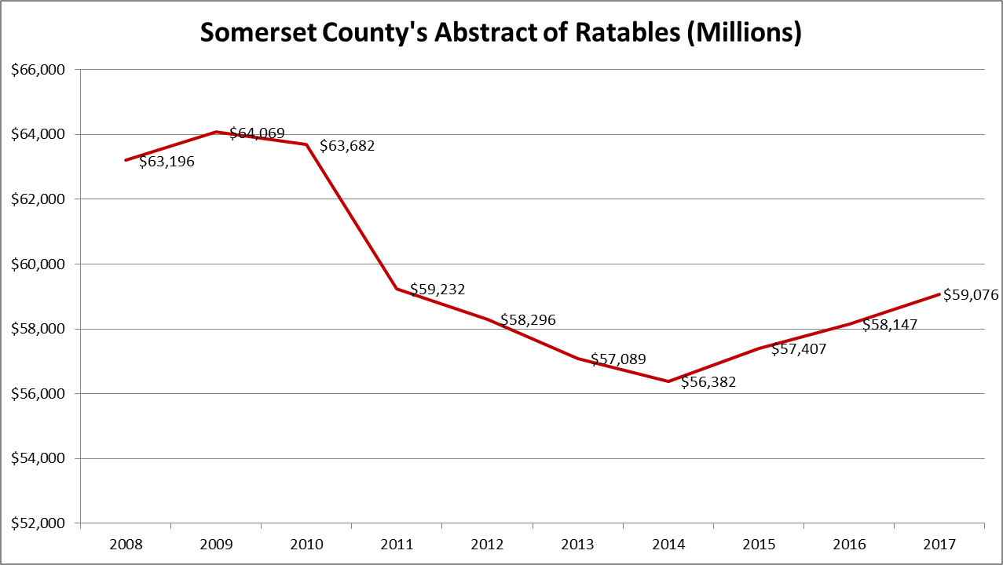
Increase In Assessed Value

Slide 24
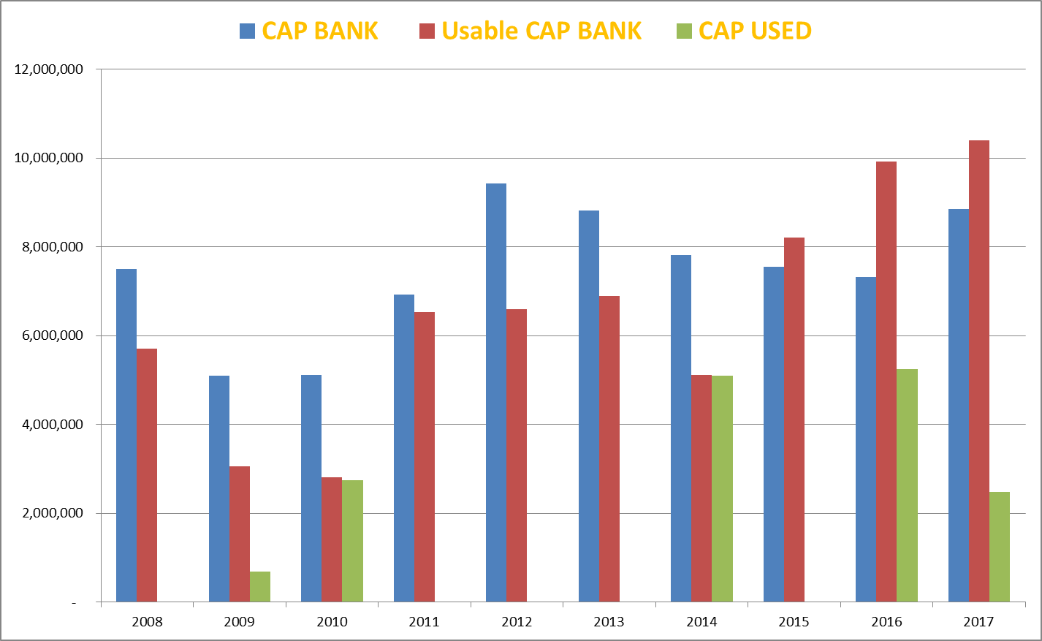
CAP BANK, CAP USED, USABLE

